Slide 1


CMR TECHNICAL CAMPUS UGC (Autonomous) Kandlakoya, Medchal Road, Hyd-501 401 Department of Computer Science and Engineering
Mini Project Review
A NOVEL METHOD FOR COMPUTATIONALLY EFFICAIOUS LINEAR AND POLYNOMIAL REGRESSION ANALYTICS OF BIG DATA IN MEDICINE
BATCH NO-10
Presented By:
207R1A05A9 : Pasala Anoohya
207R1A05B2 : Ramineni Eakta Gomati
207R1A05A2 : Munugoti Sai Nath
Project Guide:
Dr.V. Naresh Kumar
Associate Professor, CSE Department

Slide 2
CONTENTS:
Abstract
Existing System
Disadvantages of Existing System
Proposed System
Advantages of Proposed System
Hardware and Software Requirements
Novelty of the project
Architecture
Modules
UML Diagrams
Sample Code
Results
Conclusion
Future Scope
References
Github Link

Slide 3
ABSTRACT:
The abstract outlines a new approach for analyzing large datasets in medicine using linear and polynomial regression techniques.
The proposed method involves pre-processing the data, performing feature selection, and applying regularization to reduce overfitting.
The results show that the proposed method provides better accuracy and faster computation time compared to existing methods.
Overall, the study offers a promising solution for addressing the challenges of big data analytics in the healthcare industry.

Slide 4
EXISTING SYSTEM :
The existing system uses a variety of statistical software and tools for analyzing the data, including Excel and MatLab.
These tools are commonly used in statistical analysis and can handle large datasets with complex calculations.
The system includes both parametric and non-parametric models of non-Bayesian statistics.
These models can identify the relationships between variables and provide insights into the factors that may affect the outcome of the study.

Slide 5
DISADVANTAGES:
Less accuracy
Low Efficiency
Increased complexity
Limited applicability

Slide 6
PROPOSED SYSTEM:
Applying Linear & Polynomial optimization technique to Regression algorithms.
Comparing its performance without optimized Regression algorithm.
Evaluate its performance in terms of SSE.
Optimized regression giving less SSE compare to pre or without optimize Regression algorithm.

Slide 7
ADVANTAGES :
High accuracy
High efficiency
Better Predictions
More personalized medicine
Improved Research

Slide 8
HARDWARE & SOFTWARE REQUIREMENTS:
HARD REQUIRMENTS :
System : i3 or above
Ram : 4GB Ram or more
Hard disk : 40GB or more
SOFTWARE REQUIRMENTS :
Operating system : Windows
Coding Language : python 3.5

Slide 9
NOVELTY OF THE PROJECT:
Linear and polynomial regression analysis are common statistical methods used in analyzing medical data.
The novelty of the project lies in proposing a new method for computationally efficacious linear and polynomial regression analytics of big data in medicine.
This method may involve using advanced machine learning techniques, such as deep learning, to analyze large medical datasets quickly and accurately.
The proposed method may incorporate parallel computing techniques to enable the processing of vast amounts of medical data in parallel, reducing computation time and improving efficiency.

Slide 10

ARCHITECTURE:
Get
Preprocessed
Data
Remove Outliers
Apply PCA,
Create
Hyperplane
Use Gradient to identify
Extremas
Cluster Extremas and identify furthest extrema
Start
Select the principle component with highest avg. extremas in a cluster
Find Corresponding Model
Find the subspace the datapoint lies in
Test Data
End
Prediction
Set of Models
Model Training for each
subspace
Create splits Divide Dataset space
into subspaces
Training Data

Slide 11
MODULES:
UPLOAD MEDICINE DATA
PREPROCESS DATASET
TRAIN REGRESSION WITHOUT OPTIMIZATION
POLYNOMIAL OPTIMIZED LINEAR REGRESSION
PRE & POST OPTIMIZATION SSE GRAPH

Slide 12
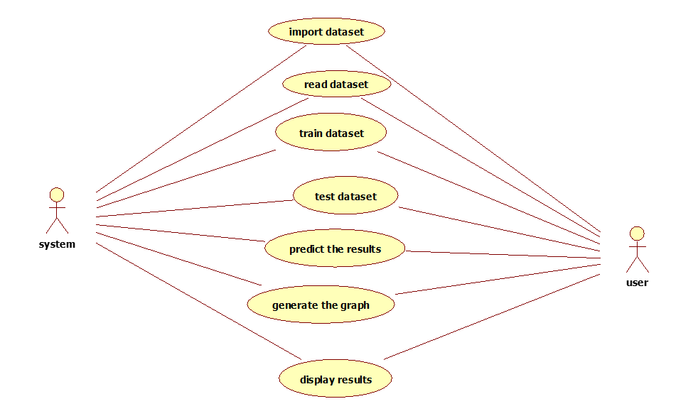
UML DIAGRAMS:
USE CASE DIAGRAM:

Slide 13
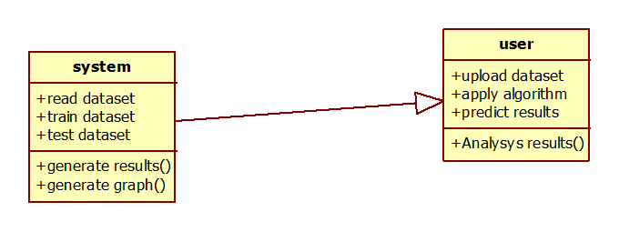
CLASS DIAGRAM:

Slide 14
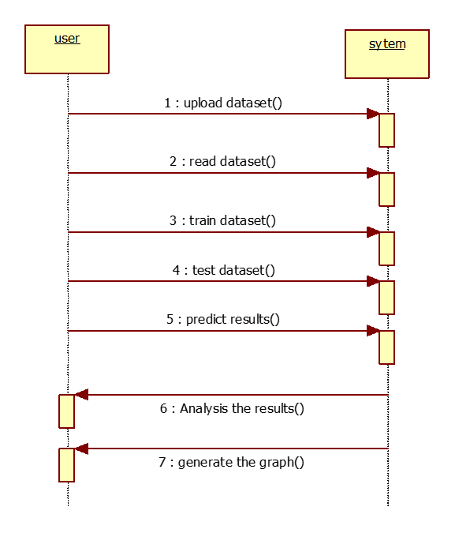
SEQUENCE DIAGRAM:
:
:System
X
X

Slide 15
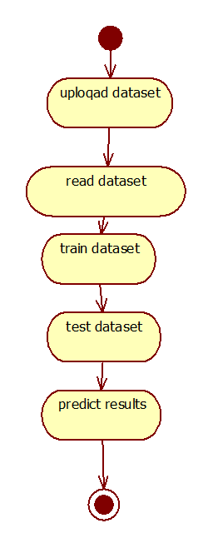
ACTIVITY DIAGRAM:

Slide 16
SAMPLE CODE:
def uploadDataset():
global filename, dataset
filename = filedialog.askopenfilename(initialdir="Dataset")
text.delete('1.0', END)
text.insert(END,filename+" loaded\n")
dataset = pd.read_csv(filename)
dataset.fillna(0, inplace = True)
text.insert(END,str(dataset.head()))
uploadButton = Button(main, text="Upload Medicine Dataset", command=uploadDataset)
uploadButton.place(x=20,y=100)
uploadButton.config(font=ff)

Slide 17
def graph():
global sse_error
print(sse_error)
existing = int(sse_error[0] / 100.0)
propose = int(sse_error[1])
print(str(existing)+" "+str(propose))
height = [existing,propose]
bars = ('Pre-Optimization SSE Error','Post-Optimization SSE Error')
y_pos = np.arange(len(bars))
plt.bar(y_pos, height)
plt.xticks(y_pos, bars)
plt.title("Pre & Post Regression Optimization SSE graph")
plt.show()

Slide 18
def runLinearRegression():
global sse_error
text.delete('1.0', END)
global X_train, X_test, y_train, y_test, sc
sse_error = []
lr = LinearRegression()
lr.fit(X, Y.ravel()) #train linear regression on dataset
predict_yield = lr.predict(X_test) #perform prediction on test data
predict_yield = predict_yield.reshape(predict_yield.shape[0],1)
predict_yield = sc.inverse_transform(predict_yield)
predict_yield = predict_yield.ravel()
y_test = y_test.reshape(y_test.shape[0],1)
labels = sc.inverse_transform(y_test)
labels = labels.ravel()
prediction(predict_yield, labels, "Linear Regression without Optimization")

Slide 19
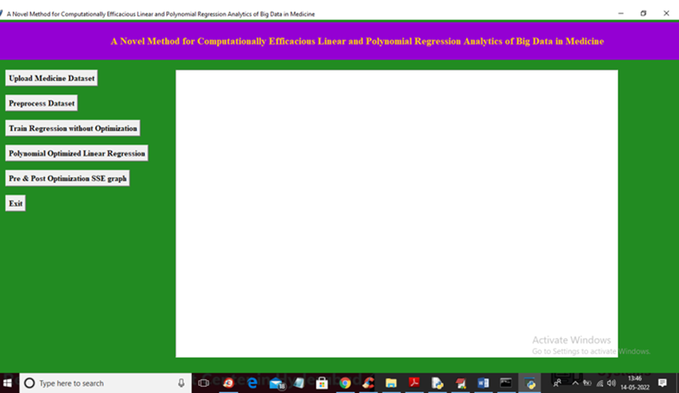
RESULTS:
Fig 1: Screen with modules

Slide 20
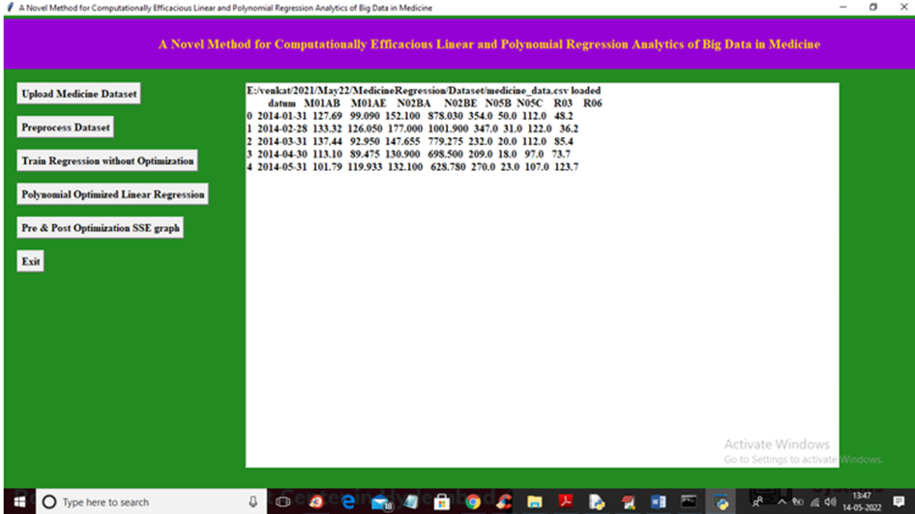
Fig 2: Uploaded dataset

Slide 21
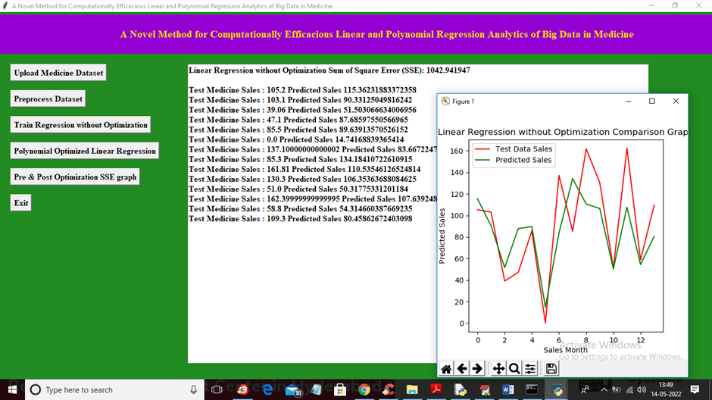
Fig 3: Linear Regression without Optimization Comparision Graph

Slide 22
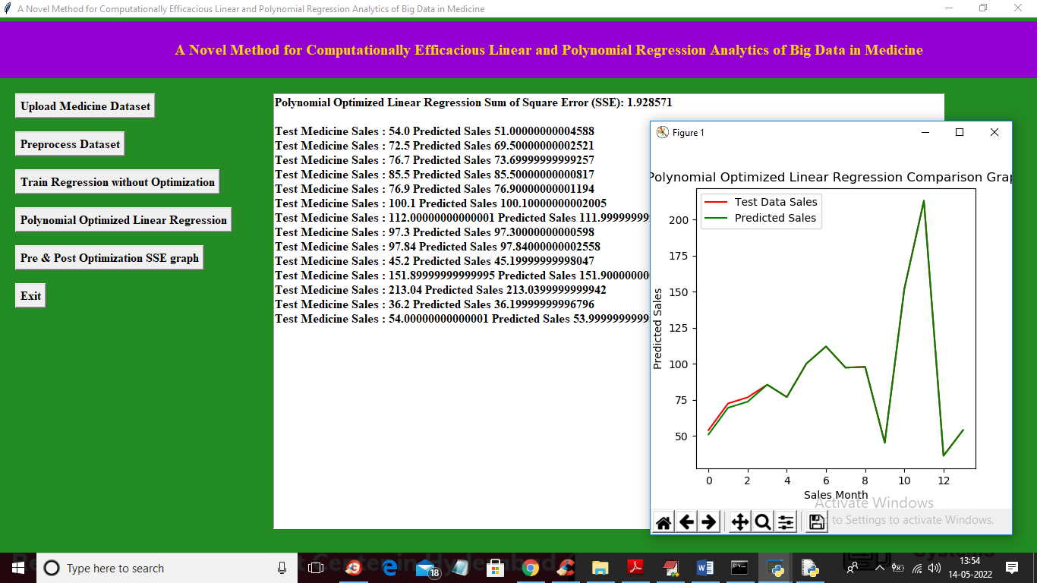
Fig 4: Polynomial Optimized Linear Regression Comparision Graph

Slide 23
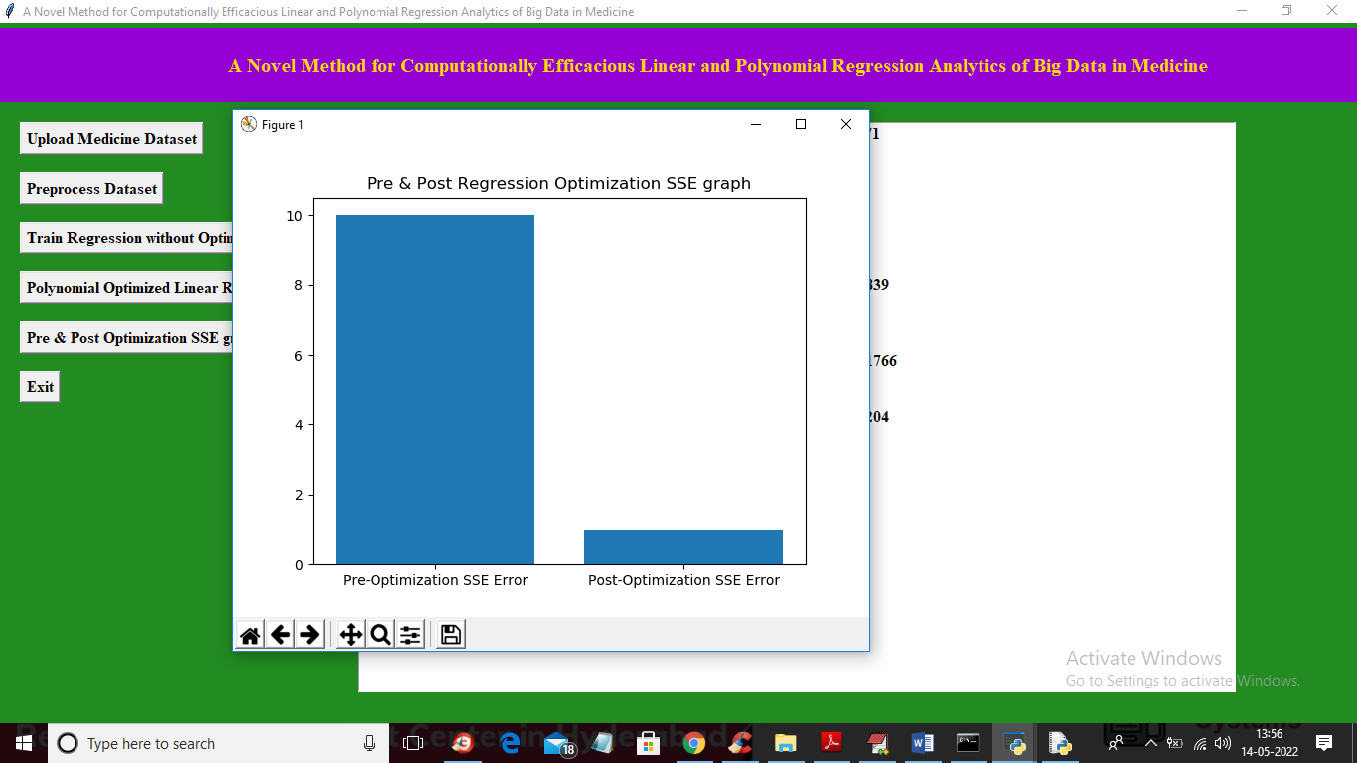
Fig 5: Pre & Post Regression Optimization SSE graph

Slide 24
CONCLUSION:
Highlights the effectiveness of the proposed approach for analyzing big data in medicine using linear and polynomial regression techniques.
The proposed approach is not only effective but also computationally efficient, making it suitable for analyzing large medical datasets.
This approach has the potential to improve medical research and patient care by enabling researchers to extract valuable insights from big data more quickly and accurately.
The study offers a valuable contribution to the field of big data analytics in medicine and highlights the potential benefits of using novel approaches to extract valuable insights from large datasets.

Slide 25
FUTURE SCOPE:
Improved Predictive Models
Clinical Decision Support
Research Advancement
Data Integration
Reduced Computational Costs

Slide 26
REFERENCES:
Al-Imam, A. (2020). Novel Psychoactive Substances Research: On the Necessity of Real-time Analytics and Predictive Modelling. Research and Advances in Psychiatry, 7(1), [in press].
Godfrey, K. (1992). Simple linear regression in medical research. Medical Uses of Statistics. NEJM Books, Boston.
Zou, K. H., Tuncali, K., & Silverman, S. G. (2003). Correlation and simple linear regression. Radiology, 227(3), 617-628.
Greenhalgh, T., Howick, J., & Maskrey, N. (2014). Evidence based medicine: a movement in crisis? BMJ, 348, g3725.

Slide 27
GITHUB LINK:
https://github.com/Anoohyapasala/Linear-and-Polynomial-Regression-Analytics-of-Big-Data-in-Medicine

Slide 28
THANK YOU

